Slide 1
Additive and Subtractive
Solid Modeling
Introduction to Engineering Design
Notes:
https://academy.autodesk.com/curriculum/f1-schools-tutorials

Slide 2
Autodesk Inventor
Autodesk Inventor is a computer-aided design application for 3D mechanical design, simulation, visualization, and documentation
This is a professional program that companies use to design a product for manufacture and production
Uses both 2D and 3D visual representations
The goal is to be able to create just about any computer model of an object from scratch

Slide 3
Autodesk Inventor
Start with PLTW unit 4.1
Watch the videos and follow directions to complete assignments
Learn the basics including navigation in the software
Terms and definitions
After completion of unit 4.1, go into Inventor and start the tutorials there
Friday we will start building our own parts

Slide 4
Assignment Friday, Feb 2
Log into Schoology
Go to Intro to Eng Design class
Download the Inventor Wksht 1,
Save to your personal folder by adding your name to the end of the file name
Complete the worksheet by editing in Word – save often!
Submit the assignment when complete

Slide 5
Assignment Monday, Feb 5
Finish the worksheet in Schoology
Inventor Wksht 1 using unit 4.1 in PLTW
Begin video tutorials about Inventor
Tutorials are also in Schoology
Start in “First” folder
Follow the tutorial in Inventor program
THERE WILL BE A QUIZ OVER THIS MATERIAL ON FRIDAY!

Slide 6
Assignment Tuesday, Feb 6
Continue video tutorials about Inventor
Tutorials are in Schoology, Inventor Videos
Start in “First” folder
Follow each tutorial in Inventor by performing the actions shown yourself
Finish the worksheet in Schoology
Inventor Wksht 1 using unit 4.1 in PLTW
THERE WILL BE A QUIZ OVER THIS MATERIAL ON FRIDAY!

Slide 7
Assignment Monday, Feb 12
Go to section 2.4 in PLTW
Open Autodesk Inventor
Create the 3 objects shown in the section called “Extend Your Learning”
These are objects numbered 6, 7, and 8
Once finished, we will create a drawing based on the 3 solid objects

Slide 8
Assignment Tuesday, Feb 13
Go to section 2.4 in PLTW
Open Autodesk Inventor
Create the 3 objects shown in the section called “Extend Your Learning”
These are objects numbered 6, 7, and 8
Once finished, we will create a drawing based on the 3 solid objects
Submit your .ipt file with your name for each drawing in Schoology

Slide 9
Assignment Wednesday, Feb 14, 2018
We have a FUN and EXCITING writing assignment for you today!!!!
Every student must write a full page
Heading must include your full legal name, today’s date, this class name, and your ELA teacher’s name
Take your time and write in as much detail as possible

Slide 10
Writing Prompt: Pick One
Write about a time in your life when you learned a lesson or resolved a problem with another person
Write about the happiest day you spent with your family or friends

Slide 11
Assignment Thursday, Feb 15, 2018
Finish objects 6, 7, and 8 in the “Extend Your Learning” section of 2.4 in PLTW
Submit your .ipt file with your name for each drawing in Schoology
Specific objective: be able to use the dimensioning tool to position individual elements of an object correctly
When finished, start on object “Coffman”

Slide 12
Assignment Monday, Feb 19, 2018
Complete object “Coffman” from handout
Submit your .ipt file with your name from Schoology
Specific objective: be able to use the dimensioning tool to position individual elements of an object correctly
Use the “line” tool, the “hole” tool, and the “arc” tool to create those specific features

Slide 13
Assignment Tuesday, Feb 20, 2018
The focus today is on learning to use more of the tools in Inventor
Watch the video in the second folder in Schoology called “spline”, follow the process shown in Inventor
Create the mouse object from scratch
Specific objective: be able to use the “spline” tool to make objects with smooth curves

Slide 14
Assignment Wednesday, Feb 21, 2018
The focus today is on learning to use more of the tools in Inventor
Watch the video in the second folder in Schoology called “spline”, follow the process shown in Inventor
Create the mouse object from scratch
Specific objective: be able to use the “spline” tool to make objects with smooth curves
Continue with the object by watching the video and following the instructions in video “Construction Geometry”

Slide 15
Assignment Monday, Feb 26, 2018
Manufacture a box
The focus today is on creating the box assembly
We first have to create each of the three individual parts in a separate drawing
We then place those parts in an assembly
We also need to finish up on our other assignments: Mouse, Coffman drawing, geometric constraints

Slide 16
Assignment Wednesday, Feb 28, 2018
Manufacture a box
The focus today is on creating the box assembly
We first have to create each of the three individual parts in a separate drawing
We then place those parts in an assembly
We also need to finish up on our other assignments: Mouse, Coffman drawing, geometric constraints
Notes:
https://academy.autodesk.com/curriculum/f1-schools-tutorials

Slide 17
Assignment Friday, Mar 2, 2018
Finish up all drawings
Coffman drawing
Mouse drawing
Refer to the “spline” video under Inventor Videos in the “second” folder
Geometric Constraints
Submit the “pattern” drawing from the video in the “third” folder
Box Assembly

Slide 18
Assignment Monday, Mar 5, 2018
Puzzle Cube
This assignment requires you to demonstrate that you have learned the basics of using Autodesk Inventor
Build the Puzzle Cube assembly from scratch without help
Start by creating each of the seven individual puzzle cube parts
Create the cube by assembling all the parts using “Mate” and “Flush”

Slide 19
Assignment Thursday, Mar 8, 2018
Puzzle Cube
This assignment requires you to demonstrate that you have learned the basics of using Autodesk Inventor
Build the Puzzle Cube assembly from scratch without help
Start by creating each of the seven individual puzzle cube parts
Create the cube by assembling all the parts using “Mate” and “Flush”

Slide 20
Assignment Friday, Mar 9, 2018
Puzzle Cube
Finish and submit the Puzzle Cube assembly
This is a major grade
Create the cube by assembling all the parts using the “Mate” and “Flush” tools in Inventor
Submit a drawing of each of the seven individual puzzle cube parts for a daily grade
If you have completed all other assignments, watch Inventor Video’s from the Third and Fourth folders – practice using new tools

Slide 21
Assignment Tuesday, Mar 20, 2018
Begin practicing advanced Inventor features and tools
Go into Schoology, Inventor Resources, open document 5_5_a_A_CADModelFeatures
This is a review of material from PLTW unit 5.5 a
Practice making each of the objects shown
Some are much harder to create than others
Submit completed part models in Schoology

Slide 22
Assignment Monday, Mar 26, 2018
Practice advanced Inventor features and tools
Go into Schoology, Inventor Resources, open document 5_5_a_A_CADModelFeatures
This is a review of material from PLTW unit 5.5 a
Submit completed part models in Schoology
DO NOT USE OTHER PEOPLE”S PART’S
Finish up all part models by Thursday
Za’Veon Class is now in session

Slide 23
Assignment Tuesday, Mar 27, 2018
Practice advanced Inventor features and tools
Go into Schoology, Inventor Resources, open document 5_5_a_A_CADModelFeatures
This is a review of material from PLTW unit 5.5 a
Submit completed part models in Schoology
DO NOT USE OTHER PEOPLE”S PART’S
Finish up all 8 part models by Thursday
When finished with 5_5_A start part models in 5_2_b

Slide 24
Assignment Wednesday, Mar 28, 2018
Practice advanced Inventor features and tools
Go into Schoology, Inventor Resources, open document 5_5_a_A_CADModelFeatures
This is a review of material from PLTW unit 5.5 a
Submit completed part models in Schoology
DO NOT USE OTHER PEOPLE”S PART’S
Finish up all 8 part models by Thursday
When finished with 5_5_A start part models in 5_2_b

Slide 25
Assignment Thursday, Mar 29, 2018
Practice advanced Inventor features and tools
Go into Schoology, Inventor Resources, open document 5_5_a_A_CADModelFeatures
Submit completed part models in Schoology
DO NOT USE OTHER PEOPLE’S PARTS
Finish up all 8 part models by TODAY!
When finished with 5_5_A start work on part models in 5_2_b
STAY BUSY!

Slide 26
Assignment Monday, April 2, 2018
Practice even more advanced Inventor features
Go into Schoology, Inventor Resources, open document 5_2_b Automoblox T9 drawings
Work on the Automoblox Connector, use the Line tool and Mirror tool to complete the part
Submit completed part models in Schoology
DO NOT USE OTHER PEOPLE’S PARTS

Slide 27
Assignment Monday, April 9, 2018
This week we continue learning about creating an assembly
We want to create a wheel assembly out of 3 parts: Automoblox axle, Automoblox tire, and Automoblox wheel
We must create the wheel first
Watch the video in the Autodesk Knowledge Network
2 wheels: simple (5 min video,daily grade) and advanced (12 min video, major grade)

Slide 28
Assignment Friday, April 13, 2018
This week we continue learning about creating an assembly
We want to create a wheel assembly out of 3 parts: Automoblox axle, Automoblox tire, and Automoblox wheel
We must create the wheel first
Watch the video in the Autodesk Knowledge Network
2 wheels: simple (5 min video,daily grade) and advanced (12 min video, major grade)

Slide 29
Assignment Friday, April 13, 2018
This week we continue learning about creating an assembly
We want to create a wheel assembly out of 3 parts: Automoblox axle, Automoblox tire, and Automoblox wheel
We must create the wheel first
Watch the video in the Autodesk Knowledge Network
2 wheels: simple (5 min video,daily grade) and advanced (12 min video, major grade)

Slide 30
Assignment Wednesday, April 18, 2018
Finish and submit your wheel assembly
The wheel assembly consists of out of 3 parts: Automoblox axle, Automoblox tire, and Automoblox wheel
Use the advanced wheel in the assembly
Watch the videos in the Autodesk Knowledge Network to create each piece
2 wheels: simple (5 min video,daily grade) and advanced (12 min video, major grade)

Slide 31
Assignment Thursday, April 19, 2018
Finish and submit your wheel assembly
The wheel assembly consists of out of 3 parts: Automoblox axle, Automoblox tire, and Automoblox wheel
Use the advanced wheel in the assembly
If you have finished all other assignments, start the miniature train project
Drawings and dimensions are found in Inventor Resources in Schoology

Slide 32
Assignment Monday, April 16, 2018
The focus this week is on the Automoblox Wheel Assembly
The assembly requires 3 parts: Automoblox axle, Automoblox tire, and Automoblox wheel
We must create the wheel first
Watch the video in the Autodesk Knowledge Network
2 wheels: simple (5 min video,daily grade) and advanced (12 min video, major grade)

Slide 33
Assignment Tuesday, Mar 6, 2018
West Point Bridge Designer 2014
PLTW unit 2.4.1, Structural Design
Follow the procedure, pay particular attention to Design Constraints and Cost Considerations
Copy all Design Constraints and all Cost Considerations onto a sheet of note paper
Today your primary objective is to learn how to use the software
Performance objective: complete the handout by filling in all the blanks

Slide 34
Assignment Thursday, Mar 8, 2018
West Point Bridge Designer 2014
PLTW unit 2.4.1, Structural Design
Follow the procedure, pay particular attention to Design Constraints and Cost Considerations
Copy all Design Constraints and all Cost Considerations onto a sheet of notebook paper
You must build a bridge that passes the load test
Performance objective: Complete and turn in the document with all Design Constraints and Cost Considerations for a major grade

Slide 35
Assignment Thursday, Mar 29, 2018
West Point Bridge Designer 2014
PLTW unit 2.4.1, Structural Design
Build a simple Howe, Pratt, or Warren truss bridge
You must build a bridge that passes the load test
Your objective is to see how material type, size, and length affect member strength
Performance objective: Complete and turn in the worksheet with all values entered
Minimize bridge cost by matching compression force, compression strength, tension force, and tension strength for each member

Slide 36
Assignment Wednesday, Mar 7, 2018
West Point Bridge Designer 2014
Be able to describe what happens when deck elevation is changed
Be able to describe what different arch abutment height does

Slide 37
Inventor Tools We Have Learned
Sketch: rectangle, circle, spline, mirror, circular pattern
3D Model: Extrude, plane, pattern
Assembly: Place, mate, flush

Slide 38
Manufacture a Box
Create 3 parts:
A top – 5 by 4 by 0.25 inches
A back – 4.5 by 4 by 0.25 inches
A side – 4 by 4 by 0.25 inches
Use a different material than the default
Color the sides according to size
Create the assembly, place each part, then constrain

Slide 39
Assignment Thursday, Feb 15, 2018
Continue working on robots through the class period
Complete the program to drive around the table back to the original location autonomously
Grade will be based on how close to the original starting location you end up
When completed work on getting the infrared remote control working

Slide 40
Assignment Friday, Feb 23, 2018
Continue working on robots through the class period
Work on getting the infrared remote control working
The program you need is on the CD-ROM in the Infrared Remote Control car folder
Success Criteria: you can drive the car around using the remote control
If you are not being productive in your group, work on completing the Arduino study guide

Slide 41
Assignment Monday, Mar 5, 2018
Continue working on robots through the class period
Work on getting the infrared remote control working
The program you need is under sample programs in the RobotC IDE
Success Criteria: you can drive the car around using the remote control
Extra credit: create the puzzle cube assembly in Inventor

Slide 42
Assignment Monday, Feb 26, 2018
Continue working on robots through the class period
Success Criteria: you can drive the car around using the remote control
The program you need is in Schoology under VEX programs
The VEX study guide will be due tomorrow
Quiz Thursday

Slide 43
Assignment Tuesday, Feb 27, 2018
Highest Priority: complete the Arduino study guide
A copy of the Arduino study guide is under “course resources” in Schoology
All information you need is in the Arduino PowerPoint in Schoology
The Arduino study guide will be due TODAY!
Quiz Thursday

Slide 44
Assignment Tuesday, Feb 27, 2018
Highest Priority: complete the VEX study guide
A copy of the VEX study guide is under “course resources” in Schoology
Information you need is in the VEX PowerPoint in Schoology and the VEX Inventors Guide
The VEX study guide will be due TODAY!
Quiz Thursday

Slide 45
Assignment Thursday, Mar 1, 2018
Finish study Guide Review
When finished with the review, you may work on your robots
We have to be able to understand how the program relates to what the robot is doing
Make the IR remote work!
Test tomorrow!

Slide 46
Assignment Friday, Mar 2, 2018
QUIZ TODAY!
Work on robots when finished
Get the IR remote working
A specific binary code is sent when you press a button
The code is read by the IR receiver
That code is tied to a function that produces an action

Slide 47
Assignment Friday, Mar 2, 2018
Continue working on robots through the class period
Work on getting the remote control working
The program you need is in Schoology in the VEX programs folder
Success Criteria: you can drive the car around using the remote control
We also need to work on having the robot drive itself autonomously

Slide 48
Assignment Thursday, Feb 15, 2018
Continue working on robots through the class period
We need to start looking at a program to make the robot move
The program we use is called RobotC
Open the program, look at the interface
Go to robotc.net to look at tutorials and try to get an introduction to this software

Slide 49
Assignment Wednesday, Feb 21, 2018
We will be starting a worksheet
Resources can be found in Schoology
Worksheet is due Friday
There will be a quiz over this material (major grade)

Slide 50
Assignment Friday, Feb 23, 2018
The focus today is on learning to use more of the tools in Inventor
Watch the video in the third folder in Schoology called “Pattern”, follow the process shown
Create the object(s) shown in the video from scratch using Inventor
Specific objective: learn how to use the “pattern” tool in Inventor
Continue by watching the next video called “construction geometry” and make the vase

Slide 51
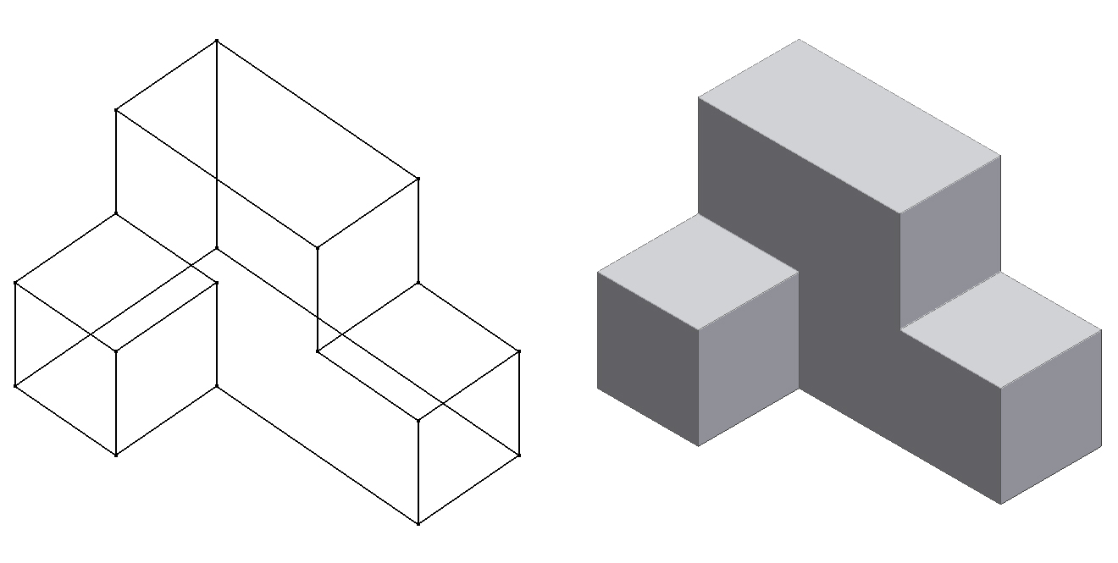
Solid Modeling
Solid modeling is a type of 3D CAD process that represents the volume of an object, not just its lines and surfaces
Wireframe
Model
Solid Model

Slide 52
Solid Modeling
Wireframe Model
A wireframe model does not give the viewer an idea of surface appearance, nor does it provide information regarding mass properties.
Wireframes are not solid models.

Slide 53
Solid Modeling
Solid Model
A solid model shows how an object’s surfaces will appear, and provides information on surface area, volume, and weight.
Notes:
[You may want to

Slide 54
Solid Modeling
Solid CAD models are the result of additive and/or subtractive processes.
All CAD solid modeling programs use additive and subtractive modeling methods to create virtual 3D objects.
They are also referred to as Boolean operations, named after the 18th century English mathematician Charles Boole.

Slide 55
Additive Methods
A three-dimensional object can be viewed as the combination of two or more simple forms.
In the creation of real-world objects, this method is represented by construction processes, such as welding, gluing, mechanical fastening, and joinery.

Slide 56
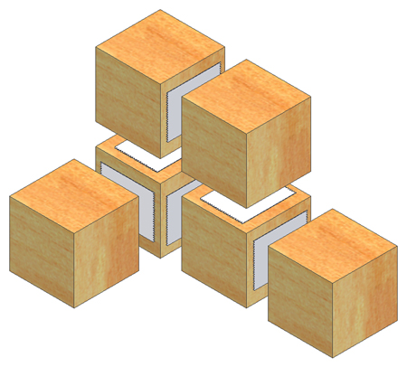
Additive Methods
0.75 in.
0.75 in.
0.75 in.
0.75 in.
Method 1
Method 2
Method 3
Notes:
We can create this part by starting with a simple form that comprises a portion of the object. Then add other simple forms to the original form. In 3D solid modeling, it is often efficient to mentally break up the object into forms that have a constant thickness.
For instance <click>, this object can be broken up into two simple forms (each with a constant thickness) <click>. This object can then be modeled in CAD by creating one of the simple forms and adding the second to the surface of the first. Note that the thickness of the first form does NOT need to be the same thickness as the second form. The important consideration is that the separate forms have a constant thickness throughout the form.
<click> Method 2 shows an alternate way in which the object can be broken into simple forms.
<click> Method 3 shows yet another division that could be used in which a single cube could be modeled and then five additional cubes added to the surface of the model to create the object.
Other divisions of the object into forms with constant thickness are also possible. Although there are many ways to model this object in the 3D solid modeling part file environment, of the options shown, it will be more efficient to create the part using Method 1 or Method 2. Method 3 would require creating five different pieces and would therefore require more steps and more time than creating the object using Method 1 or Method 2. We will walk through creation of the part using Method 1, but Method 2 would follow a similar procedure.

Slide 57
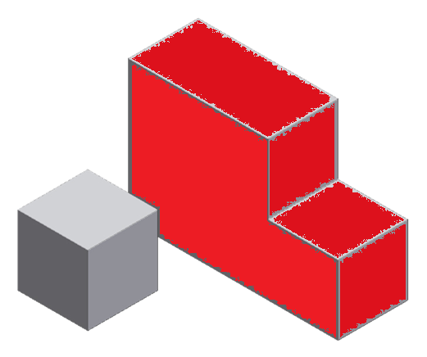
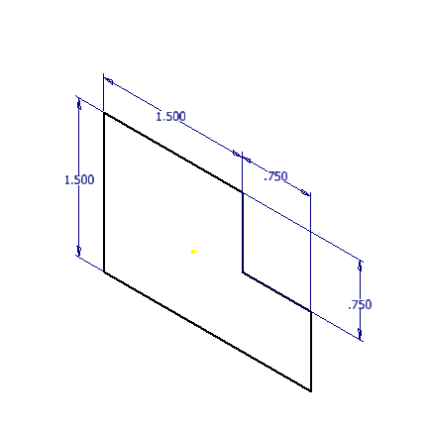
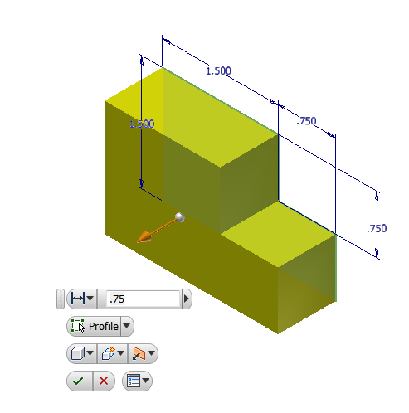
Your Turn – Additive Methods
STEP 1. Create a portion of the part with a constant thickness
Sketch and dimension a shape to represent a portion of the part with a constant thickness.
Extrude the shape to the appropriate thickness.
Notes:
Let’s create this shape in our 3D solid modeling software (Inventor) with additive methods.
First, create the larger rear “flat” portion of the part. For this example we will model the red portion of the part – it has a constant thickness of ¾ in.
Sketch and dimension the outline of a “flat” portion of the shape. Here we will start by modeling the “red” portion of the part.
Extrude the shape the appropriate distance, which is ¾ in. in this example.

Slide 58
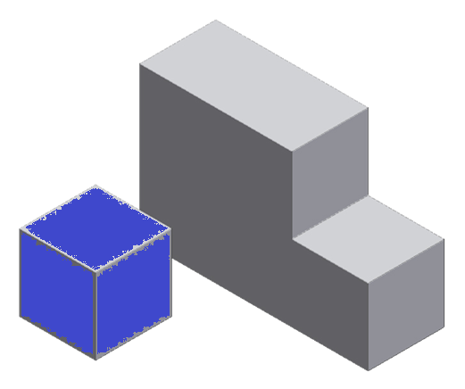
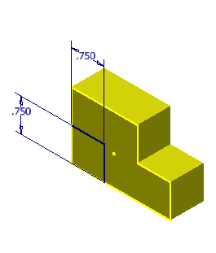
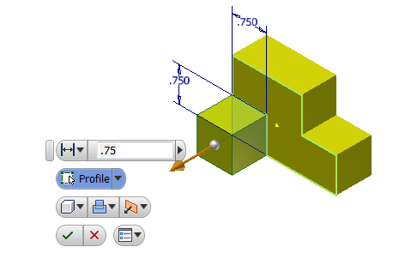
Your Turn – Additive Methods
STEP 2. Add a portion of the part with a constant thickness
Apply a sketch plane to an appropriate flat surface
Sketch and dimension a shape to represent another simple form (constant thickness)
Extrude the shape to the appropriate thickness
Notes:
Now let’s add the “blue” portion of the part that protrudes from the form already created.
Apply a sketch plane to the “front” of the existing form.
Create a sketch to represent the next portion of the part to be added. Note that the outside edges of the surface on which you apply a sketch plane with automatically be projected onto the plane. So, you do not have to sketch over the edges of the existing form.
Extrude the new shape the appropriate distance, ¾ in. in this case, to created the added form.

Slide 59
Your Turn – Additive Methods
Final Part
Notes:
We’ve added two solid forms with constant thicknesses to create the final part.

Slide 60
Subtractive Methods
An object can be viewed as the remainder of a solid block that has had the geometry of one or more forms sequentially removed.
In the creation of real-world objects, this method is represented by milling, drilling, turning, grinding, and other manufacturing processes.
Notes:
In contrast to additive methods, creating a solid model of an object using subtractive methods typically starts with a rectangular solid – a box – that would enclose the entire object. Similar to the glass box in the activity that we completed in a previous unit. Generally the initial box is created so as to be just large enough so that the object just fits within the form.

Slide 61
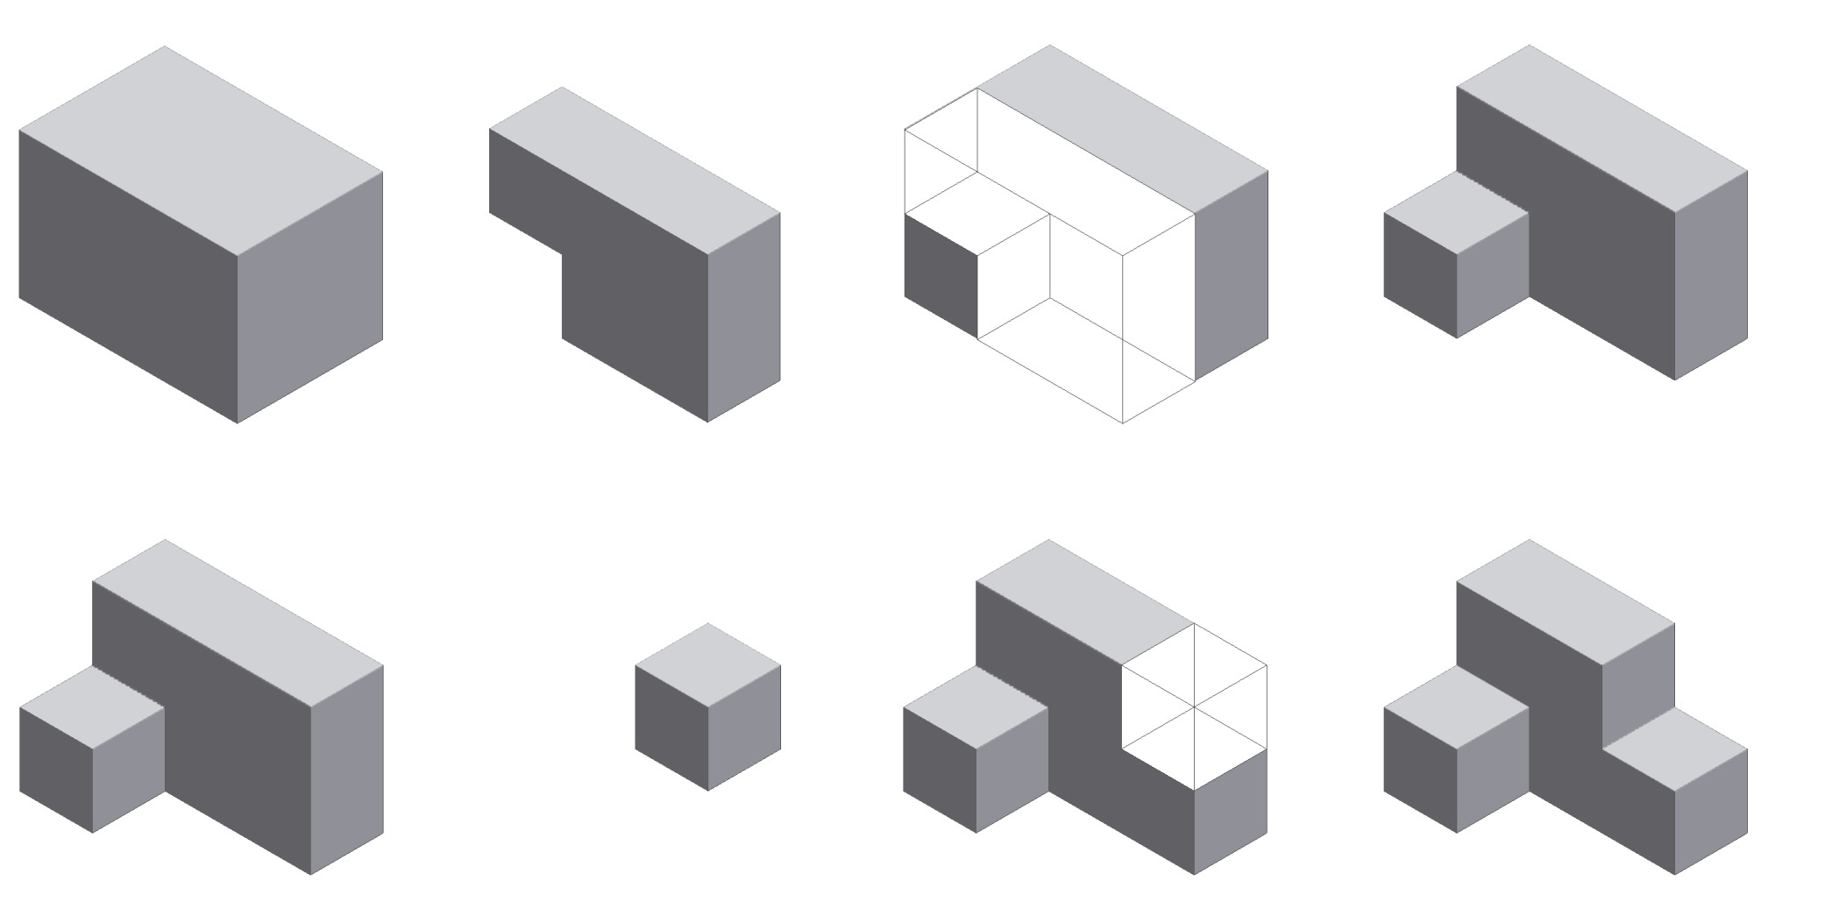
Subtractive Methods
=
=
–
–
=
=

Slide 62
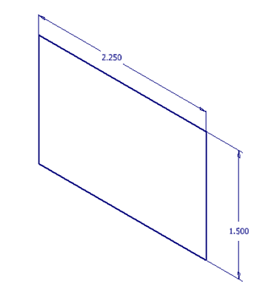
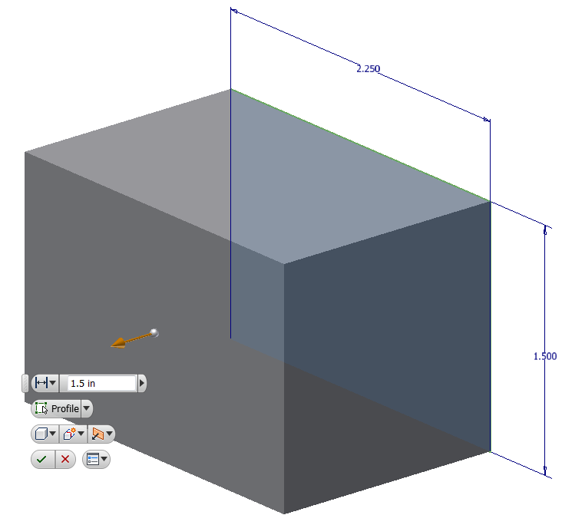
Your Turn - Subtractive Methods
STEP 1. Create a rectangular solid to enclose the object
Sketch a 2.25 in. x 1.5 in. rectangle
Extrude the rectangle 1.5 inches
Notes:
Let’s create this shape in our 3D solid modeling software (Inventor) with subtractive methods.
First, create a rectangular solid (glass box) in which the part will be enclosed.

Slide 63
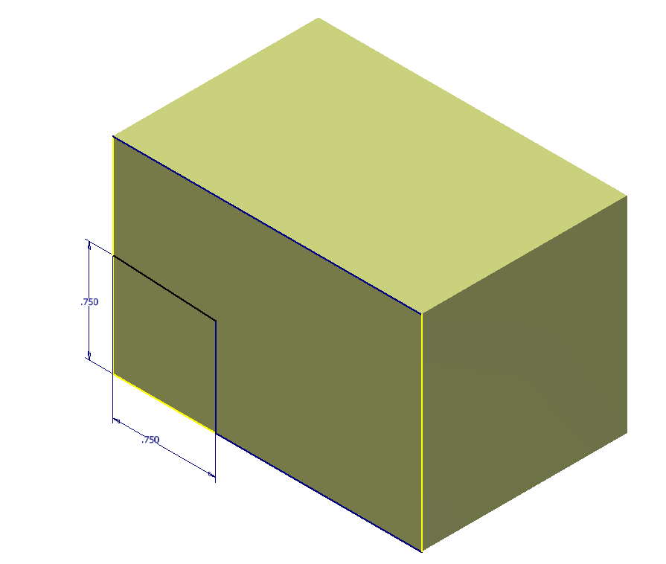
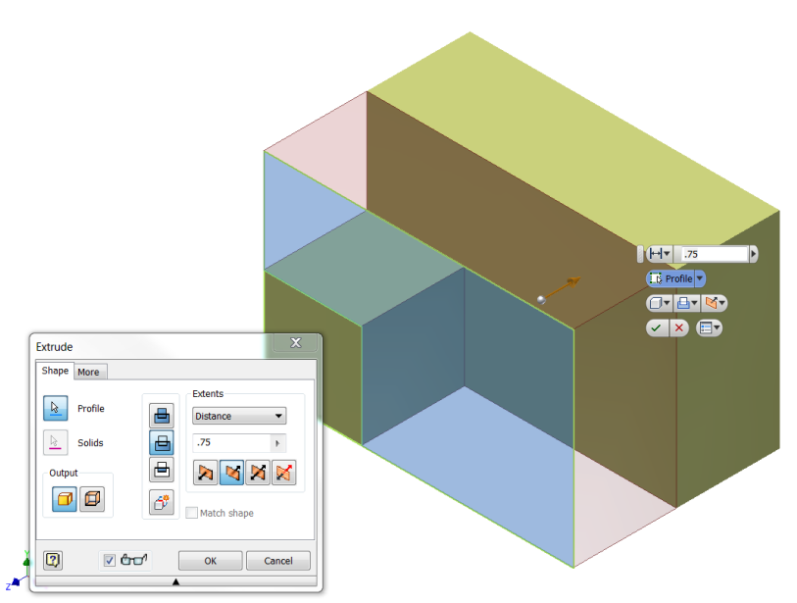
Your Turn - Subtractive Methods
STEP 2. Remove material from front face
0.75 in.
Create a sketch on the front face
Sketch the shape to be removed
Extrude Cut the shape
Notes:
The color of the part has been changed to improve visibility.
-Next, create a sketch on the front face
-Sketch the shape of the area to be removed. Note that you only need sketch the small square since the edges of the face will automatically be projected. Save the sketch.
-Extrude a cut 0.75 inches into the part.

Slide 64
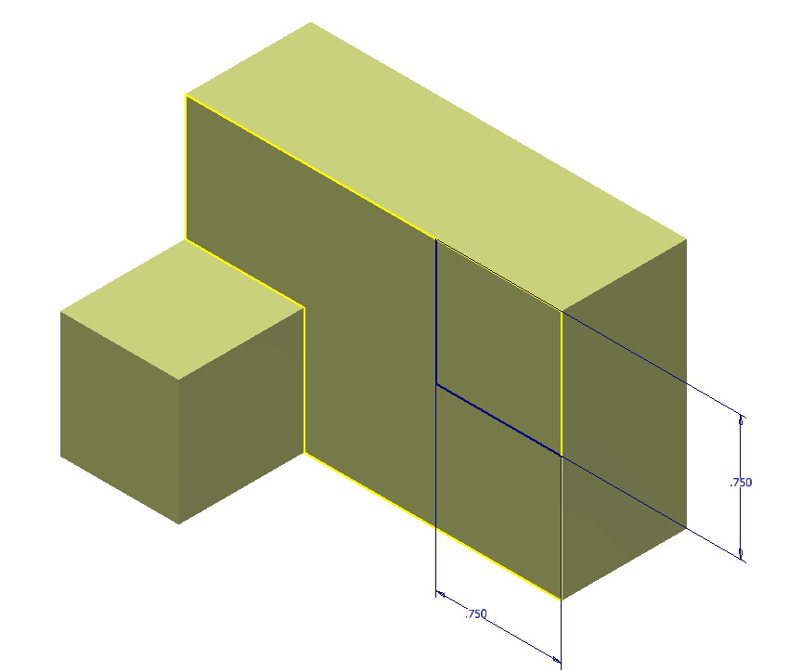
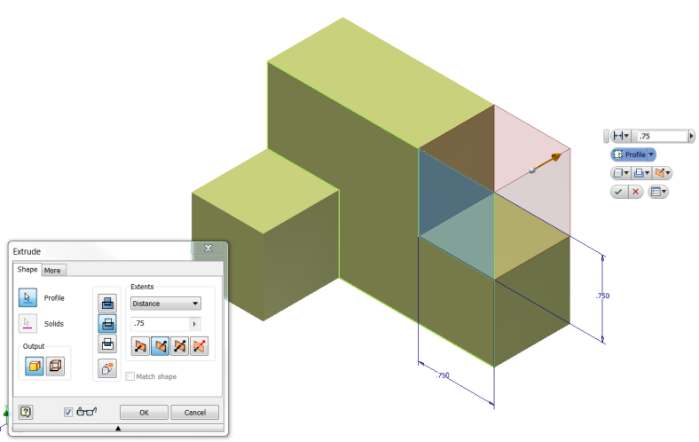
Your Turn - Subtractive Methods
STEP 3. Remove unnecessary material (upper-right corner)
Create a 2D sketch on the newly created face.
Sketch the shape to be removed.
Extrude Cut the shape.
Notes:
Now, create a 2D sketch on the newly created face.
Sketch two lines to represent the shape to be removed. Remember the outline of the surface will automatically be projected onto the sketch plane.
Then, extrude cut the shape to be removed.

Slide 65
Your Turn - Subtractive Methods
Final Part
Notes:
We created the same part using both additive and subtractive methods. In practice, there are typically many ways to create a part a part through a combination of additive and subtractive methods. It is best to consider your options before beginning to model a part in order to attempt to identify a method that will be most efficient, that is that will require less key-strokes and time to create.

Slide 66
Combining the Methods
Most objects can be modeled efficiently through the combination of both additive and subtractive methods.
There is no right or wrong way to generate a solid model. However, the process that uses the least number of steps in the shortest amount of time is the most efficient way.

Slide 67
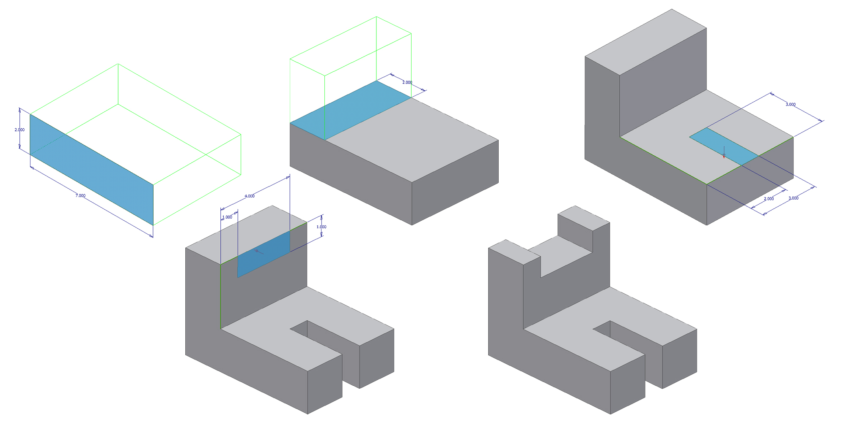
Your Turn - Combining the Methods
Additive
Subtractive
1.
2.
3.
4.
Result
Subtractive
Notes:
Create a 3D model of this part using the method shown. The dimensions are given in Activity 4.2 Model Creation. In that activity, you will recreate this part using only additive and then only subtractive methods in order to find the most efficient method for model creation.

Slide 68
Constraints
Constraints govern the position, slope, tangency, dimensions, and relationships among sketch geometry or the relative position between parts in an assembly.
The geometry that you want to constrain will limit the available options.
Notes:
Constraint definition source: http://help.autodesk.com/view/INVNTOR/2014/ENU/?guid=GUID-91C19C50-C442-41FF-940D-A637E37F5C12

Slide 69
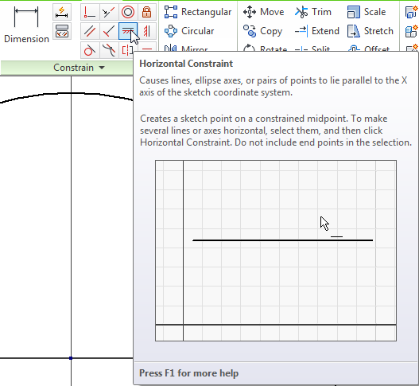
Constraints
Access commands in the Constrain tab
Point to a constraint in the tab to learn how to apply it.

Slide 70
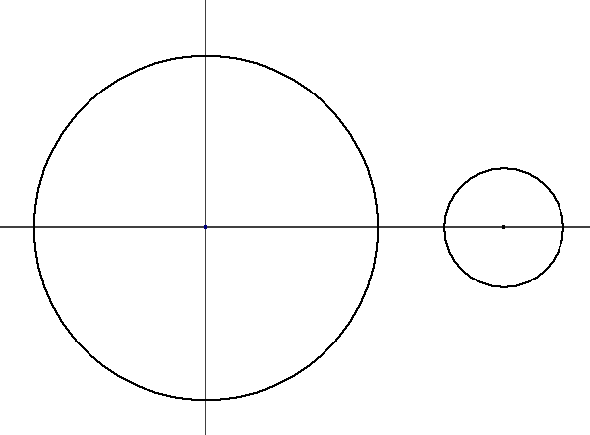
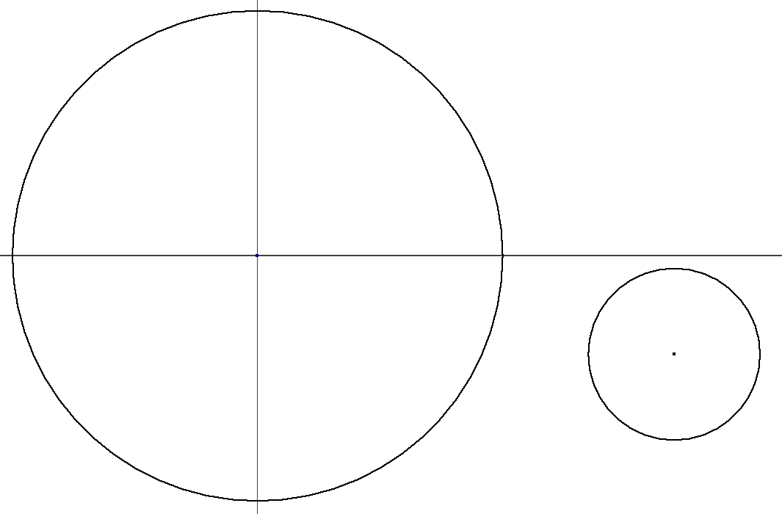
Your Turn – Horizontal Constraint
2. Select the Horizontal Constraint command
1. Create a sketch with two offset circles
4. Select the center point to define a constraint
3. Select the center point to place a constraint
Notes:
Try placing a few constraints

Slide 71
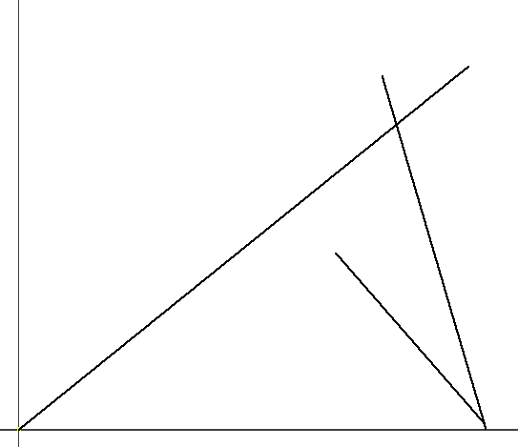
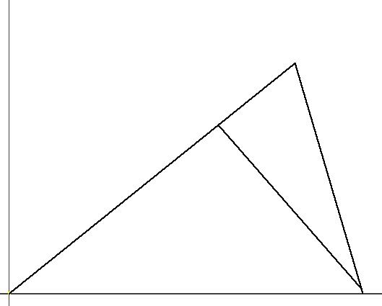
Trim and Extend Geometry
Trim and extend tools can be used to remove or extend a line or curve with respect to an existing boundary.
Trim
Extend
Notes:
Animations in slide:
[click] In the top example, the trim command was used to remove a segment of each of the two intersecting lines that extend past the intersection line.
[click] In the lower example, the extend command was used to extend a line to another line.

Slide 72
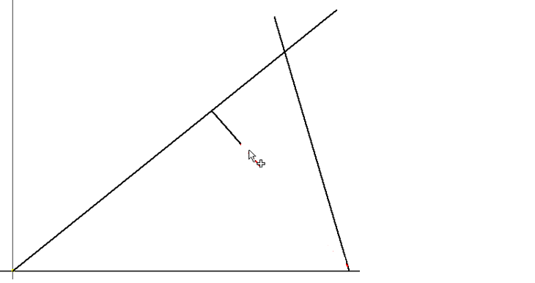
Your Turn – Trim and Extend Geometry
2. Select the Extend command
3. Hover over the geometry
1. Create a sketch to replicate the lines shown
4. Left-click to execute the command

